Slide 1
1. Commercial vinegar was titrated with NaOH solution to determine the content of acetic acid, HC₂H₃O₂. For 20.0 milliliters of the vinegar, 26.7 milliliters of 0.600–molar NaOH solution was required. What was the concentration of acetic acid in the vinegar if no other acid was present?
(A) 1.60 M (B) 0.800 M (C) 0.600 M
(D) 0.450 M (E) 0.200 M

Slide 2
16. B

Slide 3
2. H₂C₂O₄ + 2 H₂O → 2H₃O⁺ + C₂O₄^{2–}
Oxalic acid, H₂C₂O₄, is a diprotic acid with K₁ = 5.36 x 10^{–2} and K₂ = 5.3 x 10^{–5}. For the reaction above, what is the equilibrium constant?
(A) 5.36 x 10^{–2} (B) 5.3 x 10^{–5}
(C) 2.8 x 10^{–6} (D) 1.9 x10^{–10}
(E) 1.9 x 10^{–13}

Slide 4
C

Slide 5
3. Which of the following acids can be oxidized to form a stronger acid?
(A) H₃PO₄ (B) HNO₃ (C) H₂CO₃
(D) H₃BO₃ (E) H₂SO₃

Slide 6
E

Slide 7
4. When dilute nitric acid was added to a solution of one of the following chemicals, a gas was evolved. This gas turned a drop of limewater, Ca(OH)₂, cloudy, due to the formation of a white precipitate. The chemical was
(A) household ammonia, NH₃
(B) baking soda, NaHCO₃
(C) table salt, NaCl
(D) epsom salts, MgSO₄ . 7H₂O
(E) bleach, 5% NaOCl

Slide 8
B

Slide 9
5. What volume of 0.150–molar HCl is required to neutralize 25.0 milliliters of 0.120–molar Ba(OH)₂?
(A) 20.0 mL (B) 30.0 mL (C) 40.0 mL
(D) 60.0 mL (E) 80.0 mL

Slide 10
C

Slide 11
6. It is suggested that SO₂ (molar mass grams), which contributes to acid rain, could be removed from a stream of waste gases by bubbling the gases through 0.25–molar KOH, thereby producing K₂SO₃. What is the maximum mass of SO₂ that could be removed by 1,000. liters of the KOH solution?
(A) 4.0 kg (B) 8.0 kg (C) 16 kg
(D) 20. kg (E) 40. kg

Slide 12
B

Slide 13
7. A 1–molar solution of which of the following salts has the highest pH?
(A) NaNO₃ (B) Na₂CO₃ (C) NH₄Cl
(D) NaHSO₄ (E) Na₂SO₄

Slide 14
B

Slide 15
8. What is the pH of a 1.0 x 10^{–2} molar solution of HCN?
(For HCN, Ka = 4.0 X10^{–10}.)
(A) 10 (B) Between 7 and 10
(C) 7 (D) Between 1 and 7
(E) 4

Slide 16
D

Slide 17
74. A solution of calcium hypochlorite, a common additive to swimming–pool water, is
(A) basic because of the hydrolysis of the OCl– ion
(B) basic because Ca(OH)₂ is a weak and insoluble base
(C) neutral if the concentration is kept below 0.1 molar
(D) acidic because of the hydrolysis of the Ca2+ ions
(E) acidic because the acid HOCl is formed

Slide 18
A

Slide 19
Questions 10–13
(A) CO₃ ^{2–} (C) NH₄⁺ (E) Al³⁺
(B) Cr₂O₇^{2–} (D) Ba²⁺
Assume that you have an “unknown” consisting of an aqueous solution of a salt that contains one of the ions listed above. Which ion must be absent on the basis of each of the following observations of the “unknown”?
10. The solution is colorless
11. The solution gives no apparent reaction with dilute hydrochloric acid.
12. No odor can be detected when a sample of the solution is added drop by drop to a warm solution of sodium hydroxide.
13. No precipitate is formed when a dilute solution of H₂SO₄ is added to a sample of the solution.

Slide 20
B
A
C
D

Slide 21
14. The pH of 0.1–molar ammonia is approximately
(A) 1 (C) 7 (E) 14
(B) 4 (D) 11

Slide 22
D

Slide 23
15. Which of the following ions is the strongest Lewis acid?
(A) Na⁺ (C) CH3COO– (E) Al³⁺
(B) Cl– (D) Mg²⁺

Slide 24
e

Slide 25
16. Each of the following can act as both a Brönsted acid and a Brönsted base EXCEPT
(A) HCO₃– (C) NH₄⁺ (E) HS–
(B) H₂PO₄– (D) H₂O

Slide 26
C

Slide 27
17. Which, if any, of the following species is in the greatest concentration in a 0.100–molar solution of H₂SO₄ in water?
(A) H₂SO₄ molecules (C) HSO₄– ions
(B) H₃O⁺ ions (D) SO₄^{2–} ions
(E) All species are in equilibrium and therefore have the same concentrations.

Slide 28
B

Slide 29
18. Acid Acid Dissociation Constant, Ka
H₃PO₄ 7 x 10^{–3}
H₂PO₄– 5 x 10^{–9}
HPO₄^{2–} 5 x 10^{–13}
On the basis of the information above, a buffer with a pH = 9 can best be made by using
(A) pure NaH₂PO₄ (D) H₂PO₄– + HPO₄^{2–}
(B) H₃PO₄ + H₂PO₄– (E) HPO₄^{2–} + PO₄^{3–}
(C) H₂PO₄– + PO₄^{2–}

Slide 30
D

Slide 31
19. If the acid dissociation constant, Ka, for an acid HA is 8 x 10^{–4} at 25ºC, what percent of the acid is dissociated in a 0.50–molar solution of HA at 25ºC?
(A) 0.08% (C) 1% (E) 4%
(B) 0.2% (D) 2%

Slide 32
E

Slide 33
Questions 20-22
a. a solution with a pH less than 7 that is not a buffer solution
b. a buffer solution with a pH between 4 and 7
c. a buffer solution with a pH between 7 and 10
d. a solution with a pH greater than 7 that is not a buffer solution
e. a solution with a pH of 7
(Ionization constants: CH₃COOH = 1.8 x10 ^{–5}
NH₃ = 1.8 x 10 ^{–5} ;
H₂CO₃: K₁ = 4 x 10 ^{–7} ;K₂ = 4 x 10 ^{–11}
20. A solution prepared to be initially 1 M in NaCl and 1 M in HCl.
21. A solution prepared to be initially 1 M in Na₂CO₃ and 1 M in NaCH₃COO
22. A solution prepared to be initially 0.5 M in CH₃COOH and 1 M in CH₃COONa

Slide 34
20) A
21) D
22) B

Slide 35
23. In the titration of a weak acid of unknown concentration with a standard solution of a strong base, a pH meter was used to follow the progress of the titration. Which of the following is true for this experiment?
a. The pH is 7 at the equivalence point.
b. The pH at the equivalence point depends on the
c. The graph of pH versus volume of base added rises gradually at first and then much more rapidly.
d. The graph of pH versus volume of base added shows no sharp rise.
e. The [H + ] at the equivalence point equals the ionization constant of the acid.

Slide 36
C

Slide 37
24. When phenolphthalein is used as the indicator in a titration of an HCl solution with a solution of NaOH, the indicator undergoes a color change from clear to red at the end point of the titration. This color change occurs abruptly because…..
a. phenolphthalein is a very strong acid that is capable of rapid dissociation
b. the solution being titrated undergoes a large pH change near the end point of the titration
c. phenolphthalein undergoes an irreversible reaction in basic solution
d. OH – acts as a catalyst for the decomposition of phenolphthalein
e. phenolphthalein is involved in the rate–determining step of the reaction between H3O + and OH –

Slide 38
B

Slide 39
25. As the number of oxygen atoms increases in any series of oxygen acids, such as HXO, HXO2, HXO3, …which of the following is generally true?
a. The acid strength varies unpredictably.
b. The acid strength decreases only if X is a nonmetal.
c. The acid strength decreases only if X is a metal.
d. The acid strength decreases whether X is a nonmetal or a metal.
e. The acid strength increases.

Slide 40
E

Slide 41
26. H₂PO₄– + HBO₃^{2–} → HPO₄^{2–} + H₂BO₃–
The equilibrium constant for the reaction represented by the equation above is greater than 1.0. Which of the following gives the correct relative strengths of the acids and bases in the reaction?
Acids Bases
a. H₂PO₄– > H₂BO₃– HBO₃^{2–} > HPO₄^{2–}
b. H₂BO₃– > H₂PO₄– HBO₃^{2–} > HPO₄^{2–}
c. H₂PO₄– > H₂BO₃– HPO₄^{2–} > HBO₃^{2–}
d. H₂BO₃– > H₂PO₄– HPO₄^{2–} > HBO₃^{2–}
e. H₂PO₄– = H₂BO₃– HPO₄^{2–} = HBO₃^{2–}

Slide 42
A

Slide 43
27. A 0.20–molar solution of a weak monoprotic acid, HA, has a pH of 3.00. The ionization constant of this acid is
a. 5.0 x10 ^{–7} c. 5.0 x10 ^{–6} e. 2.0 x10 ^{–3}
b. 2.0 x 10 ^{–7} d. 5.0 x10 ^{–3}

Slide 44
C

Slide 45
1999 A Required
NH₃(aq) + H₂O(l) ⬄ NH₄⁺(aq) + OH–(aq)
In aqueous solution, ammonia reacts as represented above. In 0.0180 M NH₃(aq) at 25ºC, the hydroxide ion con­centration, [OH–] is 5.60 x 10^{–4} M. In answer­ing the following, assume that temperature is constant at 25ºC and that volumes are additive.
(a) Write the equilibrium-constant expression for the re­action represented above.
(b) Determine the pH of 0.0180 M NH3(aq).
(c) Determine the value of the base ionization constant, Kb, of NH3(aq).
(d) Determine the percent ionization of NH3 in 0.0180 M NH3(aq).
(e) In an experiment, a 20.0 mL sample of 0.0180 M NH3(aq) was placed in a flask and titrated to the equivalence point and beyond using 0.0120 M HCl (aq).
(i) Determine the volume of 0.0120 M HCl (aq) that was added to reach the equivalence point.
(ii) Determine the pH of the solution in the flask after a total of 15.0 mL of 0.0120 M HCl (aq) was added.
(iii) Determine the pH of the solution in the flask after a total of 40.0 mL of 0.0120 M HCl (aq) was added.

Slide 46
1996 A
HOCl <=> OCl- + H+
Hypochlorous acid, HOCl, is a weak acid commonly used as a bleaching agent. The acid-dissociation constant, Ka, for the reaction represented above is 3.2x10-8.
Calculate the [H+] of a 0.14-molar solution of HOCl.
Write the correctly balanced net ionic equation for the reaction that occurs when NaOCl is dissolved in water and calculate the numerical value of the equilibrium constant for the reaction.
Calculate the pH of a solution made by combining 40.0 milliliters of 0.14-molar HOCl and 10.0 milliliters of 0.56-molar NaOH.
How many millimoles of solid NaOH must be added to 50.0 milliliters of 0.20-molar HOCl to obtain a buffer solution that has a pH of 7.49? Assume that the addition of the solid NaOH results in a negligible change in volume.
(e) Household bleach is made by dissolving chlorine gas in water, as represented below.

Slide 47
1997 A
The overall dissociation of oxalic acid, H₂C₂O₄, is represented below. The overall dissociation constant is also indicated.
H₂C₂O₄ <=> 2 H⁺ + C₂O₄²⁻ K = 3.78x10⁻⁶
(a) What volume of 0.400-molar NaOH is required to neutralize completely a 5.00 x 10⁻³ mole sample of pure oxalic acid?
(b) Give the equations representing the first and second dissociations of oxalic acid. Calculate the value of the first dissociation constant, K1, for oxalic acid if the value of the second dissociation constant, K2, is 6.40 x 10⁻⁵.
(c) To a 0.015-molar solution of oxalic acid, a strong acid is added until the pH is 0.5. Calculate the [C₂O₄²⁻] in the resulting solution. (Assume the change in volume is negligible.)
(d) Calculate the value of the equilibrium constant, Kb, for the reaction that occurs when solid Na₂C₂O₄ is dissolved in water

Slide 48
1998 D (Required) [repeated in lab procedures section]
An approximately 0.1-molar solution of NaOH is to be standardized by titration. Assume that the following materials are available.
Clean, dry 50 mL buret, 250 mL Erlenmeyer flask, Wash bottle filled with distilled water, Analytical balance, Phenolphthalein indicator solution, Potassium hydrogen phthalate, KHP, a pure solid monoprotic acid (to be used as the primary standard)
(a) Briefly describe the steps you would take, using the materials listed above, to standardize the NaOH solution.
Describe (i.e., set up) the calculations necessary to determine the concentration of the NaOH solution.
CONTINUED ON NEXT SLIDE

Slide 49
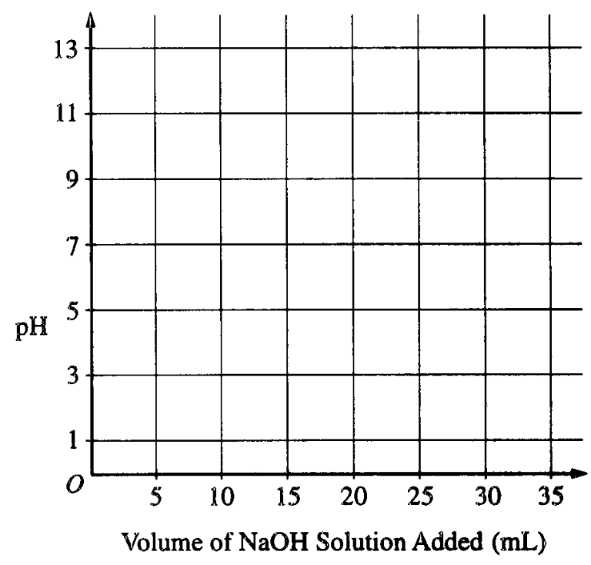
(c) After the NaOH solution has been standardized, it is used to titrate a weak monoprotic acid, HX. The equivalence point is reached when 25.0 mL of NaOH solution has been added. In the space provided at the right, sketch the titration curve, showing the pH changes that occur as the volume of NaOH solution added increases from 0 to 35.0 mL. Clearly label the equivalence point on the curve.
Parts D and E continued on the next slide

Slide 50
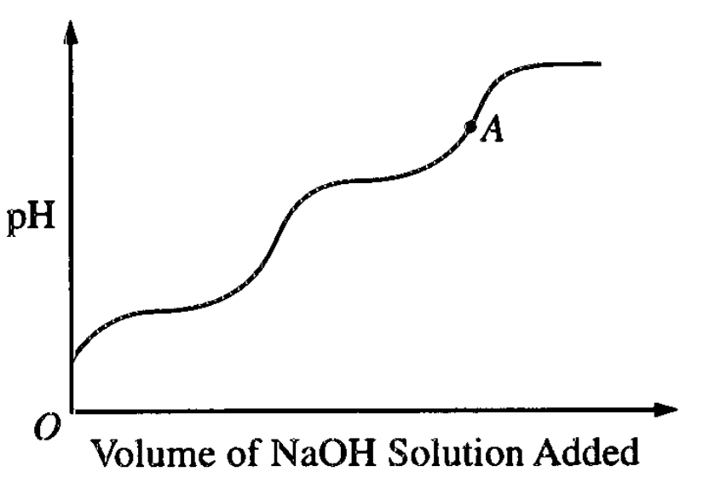
(d) Describe how the value of the acid-dissociation constant, Ka, for the weak acid HX could be determined from the titration curve in part (c).
(e) The graph below shows the results obtained by titrating a different weak acid, H2Y, with the standardized NaOH solution. Identify the negative ion that is present in the highest concentration at the point in the titration represented by the letter A on the curve.

